Slide 1

Lesson 4.03: Nested For Loops
Microsoft Philanthropies TEALS Program
Introduction to Computer Science
Semester 2

Slide 2
Nested For Loops
After this lesson, you will be able to...
Define and identify nested for loops, stack trace
Demonstrate for loops using a function and a for loop
Demonstrate nested loops using an outer and an inner for loop
Use stack trace to demonstrate the flow of nested for loops

Slide 3
Today’s Plan
Day 1
Do Now
Lesson
Lab
Debrief
Day 2
Do Now
Review
Lab
Debrief
Notes:
Day 1
Duration Description
5 Minutes Do Now
10 Minutes Lesson
35 Minutes Lab
5 Minutes Debrief
Day 2
Duration Description
5 Minutes Do Now
10 Minutes Review
35 Minutes Lab
5 Minutes Debrief

Slide 4
Do Now – Part 1
Enter the following code into your console
def print_6_stars():
my_string = ''
for i in range(0, 6):
my_string += ' *'
print (my_string)
print_6_stars()
Write down the output of the function print_6_stars().
Notes:
* * * * * *

Slide 5
Do Now – Part 2
Write a function print_star_squares
Call print_6_stars in a loop to output the following:
* * * * * *
* * * * * *
* * * * * *
* * * * * *
* * * * * *
* * * * * *
Rewrite the function print_star_squares without using print_6_stars.
Notes:
Can write it as a loop within a loop or a loop calling a function that loops producing the line of stars.

Slide 6
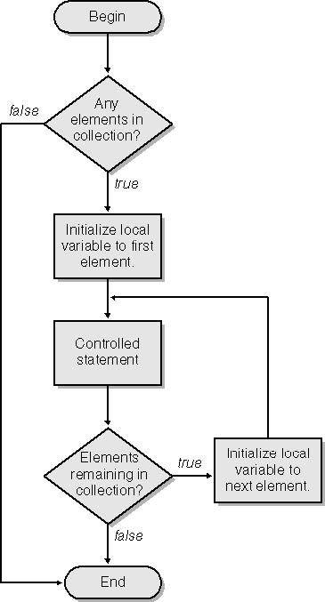
Nested for Loop
Nested for loop
a loop inside another loop
The first loop is called the outer loop
The second loop is called the inner loop
For each iteration of the outer loop, the inner loop cycles through all of its iterations
For a nested loop,
place the inner loop after the outer loop's controlled statement.
Notes:
Instructors / volunteers: The link mentioned in the 4.03 Lesson document can optionally be showed in class at this point -- https://youtu.be/fyP4SXpkYG4

Slide 7
Alternative Activity
Count From 20 to 99
How do you count from 20 to 99, using words not digits?
Say the words "twenty" through "ninety-nine" quickly.
Describe your process. What exactly is the repeating pattern that could be used by a computer program?

Slide 8
Alternative Activity - Count From 20 to 99
# Nested Loops using len() and range()
tens = ['twenty', 'thirty', 'forty', 'fifty', 'sixty', 'seventy', 'eighty', 'ninety']
ones = ['', 'one', 'two', 'three', 'four', 'five', 'six', 'seven', 'eight', 'nine']
for i in range(0, len(tens)):
for j in range(0, len(ones)):
if j == 0:
separator = ''
else:
separator = '-'
print(tens[i] + separator + ones[j])
Notes:
The initial 0 in the range function calls is an optional parameter, so for i in range(len(tens)): would work the same as
for i in range(0, len(tens)):

Slide 9
Alternative Activity - Simplification
# Nested Loops using "for ... in ..." syntax
tens = ['twenty', 'thirty', 'forty', 'fifty', 'sixty', 'seventy', 'eighty', 'ninety']
ones = ['', 'one', 'two', 'three', 'four', 'five', 'six', 'seven', 'eight', 'nine']
for tens_digit in tens:
for ones_digit in ones:
print(tens_digit + '-'[0:len(ones_digit)] + ones_digit)
This is a simpler version of the same code.
The for ... in ... syntax can be used whenever list index values are not actually needed in the code.
Optional: Line 6 of this code uses a trick with slice syntax, applied to the string '-'. A dash is printed only if ones_digit is non-empty. Why does this trick work?
Notes:
Line 6 can be used as a quick review of slice syntax. The slice '-'[0:len(ones_digit)] starts at position 0 of the string '-'. If ones_digit has length zero, it prints zero characters from that string. Otherwise it prints more than zero characters. Since there is only one character in the string, a hyphen is always printed unless ones_digit is an empty string.

Slide 10
Labs - Drawing images using nested for loops
For each of the following labs, write a function that will draw the desired output.
You may use an extra function if you find it helpful.

Slide 11
Lab 1
Write a function, draw_7(), to draw the 7x7 square:
* * * * * * *
* * * * * * *
* * * * * * *
* * * * * * *
* * * * * * *
* * * * * * *
* * * * * * *

Slide 12
Lab 2
Write a function, stars_and_stripes(), that will draw 3 pairs of rows -- first a row of 7 stars, followed by a row of 7 dashes:
* * * * * * *
- - - - - - -
* * * * * * *
- - - - - - -
* * * * * * *
- - - - - - -

Slide 13
Lab 3
Write a function, increasing_triangle(), that will print out the following when the value 7 is passed in to the function:
1
12
123
1234
12345
123456
1234567

Slide 14
Lab 4: Bonus Lab Problem
Use a function to create your own pattern or drawing.
Optionally, ask for numeric input from the user. Don't forget to cast the response from a string to a numeric value.
Different user resonses should result in some change to the printed pattern (e.g., size or shape).
String inputs can also be used if needed.

Slide 15
Exit Ticket/Reflection
Inform students that there will be a Unit 4 Quiz after Lesson 4.04.
Go over common questions the students have.

